Slide 1

I get inspiration for my project is from this holy verse.

Slide 2
LstVoyez
A peaceful journey to heaven

Slide 3
LSTvoyez
LST - is the short form of the word Last
VOYEZ - is representing the final journey after death .
Brief about my application :
My Project is based on an Application which is mainly a directory of all the major religious funeral services. and service provider like legal , catering venue and other service related that may people need during their loved ones final journey. A one stop solution for all the service related to the service .
Purpose :
when a loved one passes away it is hard to deal.. User will be able to access the app for browsing funeral services based on their location and requirement , businesses and charities can register as a service provider as well . Application can be run as commercial or no-profitable service purpose .

Slide 4

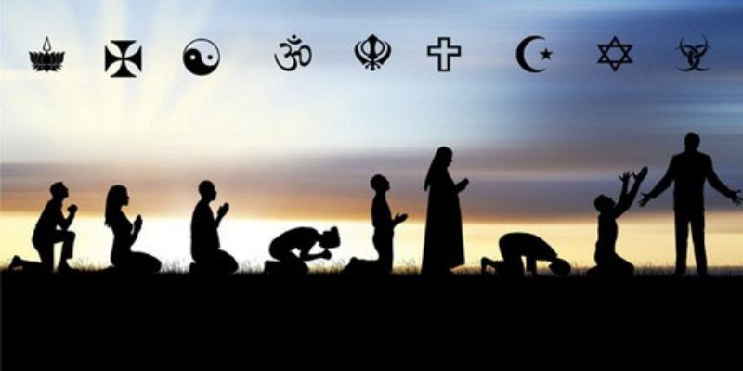
LST-Voyez
Register
Search Local
Home
Services

Slide 5
List of the religions
List of services
Christan 1
Christan 2
Hindu
Islam
Buddist
Jewish
Funeral
Venue
Catering
Legal
Jobs-Hire extra hands/ Freelance
Transport hire

Slide 6
What make it special ?
All in one platform
Compare and personalized
User will be able to access most services in one place according tot heir needs ,
Covering most of the major beliefs.
A platform for the small busines to reach target customers .
User will be able to compare prices and services and review and give feedback .
Charities can be found who supports providing all the funeral services .

